Slide 1
Making Smoke Alarms Better & Safer
CC-Tut4-Group-6
Kevin : 510562278 | Pratul : 510604305 | Zeeshan : 510370813 |Seyun : 510075516
Notes:
Hi everyone, we are group 6, here to present our project - “Making Smoke Alarms Better and Safer”.
Add after presentation :

Slide 2
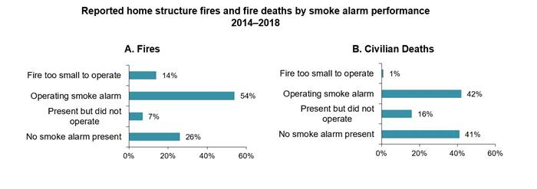
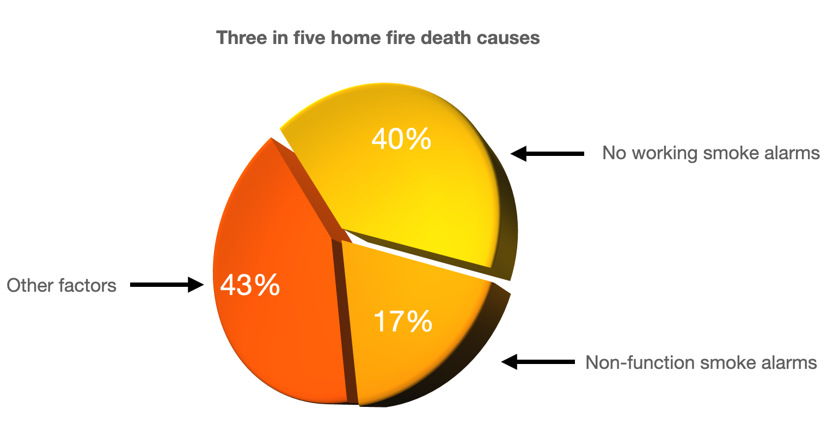
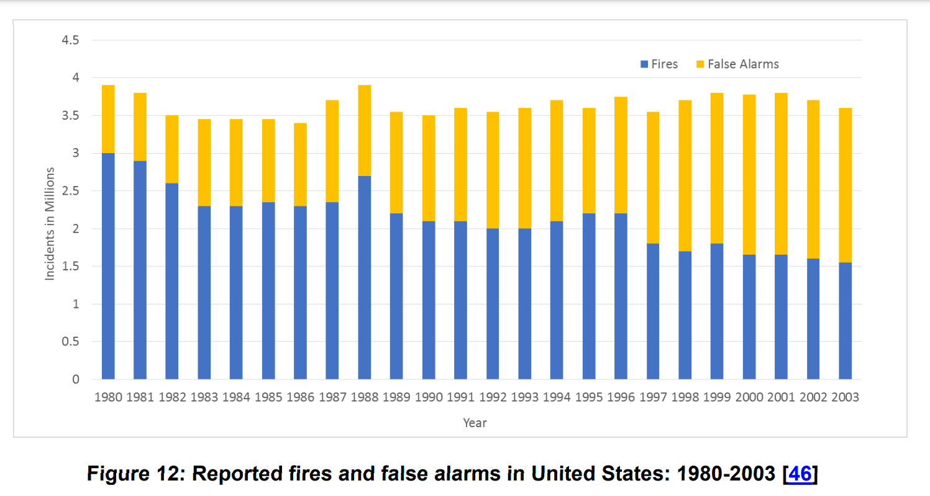
Background
97% False fire alarms report in Australia in 2015.
Ionisation smoke alarms have a staggering 55% failure rate.
16-17% of human fatalities caused by faulty smoke alarms.
Fig 2: Civilian deaths caused by home structure fires [2]
Fig 1: Smoke alarm statistics [1]
Fig 3: US reported fires and false alarms [3]
Notes:
A little bit of background to our project. Smoke detectors help save a lot of lives. But, these smoke alarms aren’t always perfect, and over the years there has been an increase in the number of false alarms too. As you can see from this bar graph millions of false alarms are raised every year. These unwanted alarms reduce public trust in their effectiveness and also waste crucial fire department resources.
Shockingly, Ionisation smoke alarms, which are the most common type of smoke alarms available, have a 55% failure rate. This means, in more than half the cases of real fire emergencies, these alarms fail to detect them and sound an alert. Moreover, 16-17% of human fatalities are caused by faulty smoke alarms.
For our project, we used a dataset of more than 60,000 observations containing data about 15 different parameters that contribute to a smoke alarm’s decision. Other similar studies have been performed using this dataset and we intend to confirm their findings using our own independent study.

Slide 3
Problem Statement
Enhance safety & efficiency of smoke alarms by optimising a machine learning model to reduce false negatives and increasing accuracy & true positives.
Notes:
As our problem statement states we aim to Enhance safety & efficiency of smoke alarms by optimising a machine learning model to reduce false negatives and increase accuracy of its true positives.
In this project, our team aims to reduce the number of false negatives to save human lives and to reduce the false positives, i.e. false alarms to save fire department resources.
We intend to achieve our objectives by first identifying the features that contribute the most to the fire alarm’s decisions and then training machine learning models using those.

Slide 4
METHODS
Notes:
As the No Free Lunch Theorem states, no one algorithm works best for every problem. Therefore, it only makes sense for us to train several different machine learning models on our dataset and analyse which ones work best according to our pre-defined objectives and measures of performance like Accuracy, AUC score and False Negative Rate.

Slide 5
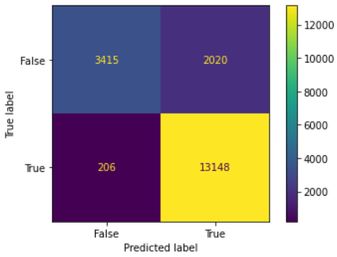
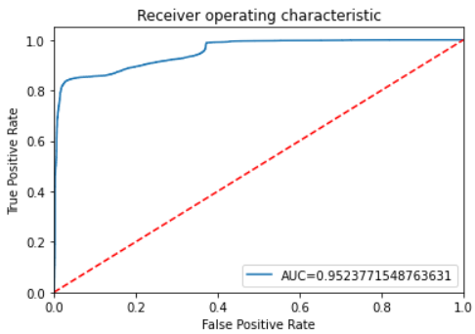

Logistic Regression
Accuracy | 0.88 | High
False Negative Rate | 1.1% | Low
AUC score | 0.95 | Very High
Mean Absolute Error | 0.11 | Low
Notes:
First, we tried the Logistic Regression model with which we achieved an accuracy of 0.88 and a False Negative rate of 1.1%. This means that there were as many as 200 cases out of 15,000 observations where the smoke alarm failed to sound an alert.
With an AUC score of 0.95, the ROC curve for this model is nearly perfect, which means that the model is quite good at distinguishing between positive and negative cases. The Mean Absolute Error rate of 0.11 and a moderately high accuracy of 0.88 makes this model a potential improvement over the existing smoke alarms in the world.

Slide 9
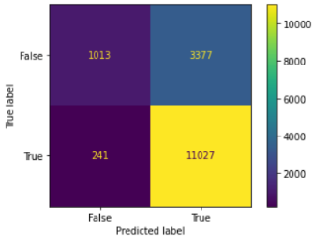
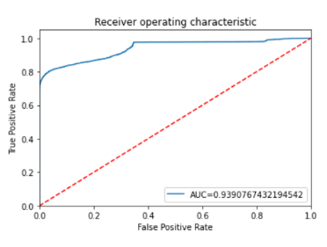
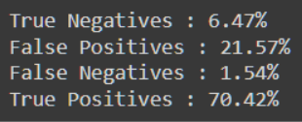
Gaussian Naive Bayes
Accuracy | 0.77 | High
False Negative Rate | 1.5% | Low
AUC score | 0.93 | High
Mean Absolute Error | 0.23 | Low
Notes:
Secondly, Gaussian Naive Bayes turned out to be an ineffective model. While it scores a high AUC score, almost all other models do too, and even with low false negative rate of 1.5%, it shows no exceptional benefits over other models and as a result it is not a model we would recommend.

Slide 10
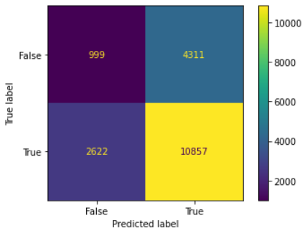
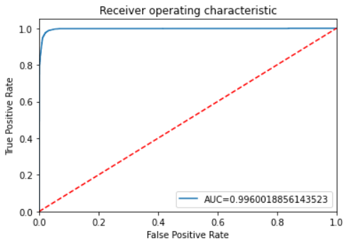
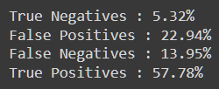
Multi-layer Perceptron Classifier
Accuracy | 0.98 | Very High
False Negative Rate | 14% | Very High
AUC score | 0.99 | Very High
Mean Absolute Error | 0.36 | High
Notes:
With the MLP Classifier model, we achieved an amazing accuracy of 0.98 but a shocking False Negative rate of 14%. That’s 2600 cases where the smoke alarm failed to sound an alert.
With an AUC score of 0.99, the ROC curve for this model is again nearly perfect. With the Mean Absolute Error rate as high as 0.36 and a massive False Negative Rate, this model is highly unusable.

Slide 11
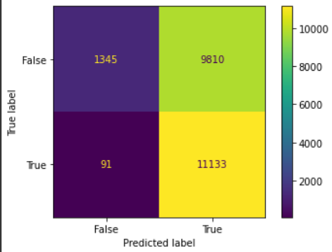
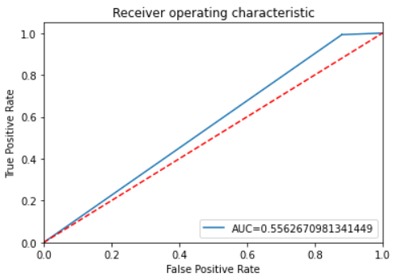
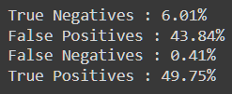
Multinomial Naive Bayes
Accuracy | 0.56 | Low
False Negative Rate | 0.4% | High
AUC score | 0.56 | Very Low
Mean Absolute Error | 0.44 | Very Low
Notes:
Now on to the Multinomial Naive Bayes model, we observed a really bad accuracy of 0.56 and although the False Negative rate of 0.4% gives some hope, the dismal accuracy and mean absolute error scores make it absolutely certain that this model cannot be recommended for use at all.

Slide 12
Weighted K-Nearest Neighbours
Accuracy | 0.99 | Very High
False Negative Rate | 1.5% | Very Low
AUC score | 0.99 | Very High
Mean Absolute Error | 0.0003 | Very Low
Notes:
Now we move on to the KNN classifier, which sometimes can be quite sensitive to outlier values and from other classes.
To overcome this problem, we train two separate models. One, the default unweighted classifier (KNN), and another a weighted-KNN , where the nearest k points are assigned a weight inversely proportional to their distance.
Both these models were trained on a number of different values of k to find the highest accuracy.
With the Weighted KNN model we achieved an almost perfect accuracy and a False Negative rate of 0.04% . This means there were only 2 instances where the smoke Alarm should have gone off but didn’t, which is impressive considering that our dataset has over 15,000 observations.

Slide 13
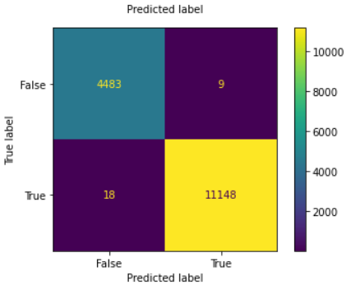
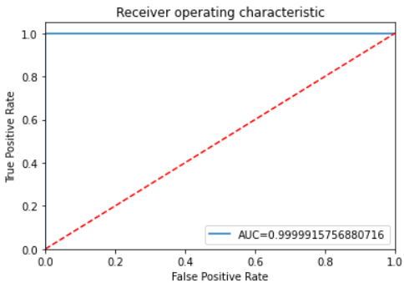

Unweighted K-Nearest Neighbours
Accuracy | 0.99 | Very High
False Negative Rate | 0.1% | Very Low
AUC score | 0.99 | Very High
Mean Absolute Error | 0.0003 | Very Low
Notes:
Whereas for our unweighted KNN model, the highest accuracy achieved was relatively similar to weighted KNN and a False Negative rate of 0.11%. This means there were only 18 instances where the Smoke Alarm should have gone off but didn’t. The ROC curve is perfect as the AUC score is nearly 1.0, which means that the model is really good at distinguishing between positive and negative cases.
Since the ROC curve and accuracy suggest that this model is extremely effective, the Mean Absolute Error rate and false negative rates of almost 0 verifies our results and therefore suggests that this model is a massive improvement over existing options and is only marginally weaker than its weighted counterpart.

Slide 14
Key Findings
Model | Accuracy | AUC | False Negatives | Mean Absolute Error
Weighted KNN | 0.999845 | 0.999888 | 0.04% | 0.0001
Unweighted KNN | 0.99975 | 0.999955 | 0.02% | 0.0003
MLP Classifier | 0.98382 | 0.996169 | 13.27% | 0.3617
Logistic Regression | 0.88536 | 0.955191 | 1.15% | 0.1146
Multinomial Naive Bayes | 0.75061 | 0.554376 | 0.51 % | 0.2493
Gaussian Naive Bayes | 0.767020 | 0.937225 | 1.62% | 0.2330
Recommended models are KNN and WNN.
Highest accuracy & Lowest false negative.
Other models lacked in either accuracy or False Negatives.
Notes:
From our findings, we have derived that KNN and WNN were the most accurate models by a large margin, each with accuracies of over 0.999 and false negatives below 0.04%. These are almost absurd numbers compared to the rest of the models. MLP Classifier has a similar accuracy but has a false negative of over 13%. Other models lacked in accuracy with sub 0.9 accuracies. Every model had an impressive AUC score of over 0.9, except for Multinomial Naive Bayes, which scored an exceptionally low 0.55. Our findings prove that having the right model to enhance smoke alarms is essential, as it could mean a 20+% difference in accuracy, which is a substantial number considering that smoke alarms can prevent catastrophic hazards that could potentially take lives.

Slide 15
Recommendations to Stakeholders
Stakeholders :
General Public
Smoke Alarm Manufacturers
Develop Safer & Affordable smoke alarms
Capitalise on global $30 Billion industry
Readily upgradable tech-powered versions
Disrupt existing unsafe options
Notes:
Our stakeholders are leading Smoke Alarm Manufacturers like ABB, Bosch, Honeywell and the general public
With our outstanding KNN model, we can develop the next generation of smoke alarms and commercialise the product
We can help make a dent in this $30 billion industry and boost public confidence by providing safer and reliable alternatives
Advanced versions of our model can be used to categorise and label the types of fires by their source which further helps us to develop better versions

Slide 16
Thank You!

Slide 17
References
[1] My smoke alarm, "SMOKE ALARM STATISTICS," [Online]. Available: https://www.mysmokealarm.org/smoke-alarm-statistics/.
[2] V. Novozhilov, L. Shi , . M. Guerrieri, K. Moinuddin, . D. Bruck and P. Joseph, "Australian Building Codes," 2015.
[3] M. Ahrens, "Smoke Alarms in US Home Fires," February 2021. [Online]. Available: https://www.nfpa.org/News-and-Research/Data-research-and-tools/Detection-and-Signaling/Smoke-Alarms-in-US-Home-Fires.

